Slide 1
CASE STUDY – PYF2206R1
PROJECT TITLE :
MAKE THE APPLICATION FOR EMPLOYEE MANAGEMENT
USING TWINTER IN PYTHON
Reported on : 21 Sep 2022
Prepared by : Pham Thi Hang
Instructed by: Teacher. Do Van Duong

Slide 2
a. APPLICATION Description

Slide 3
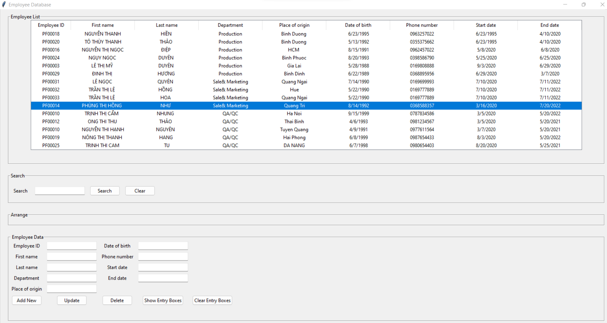
Description
Purpose
- Manage the employee information: employee ID, Name, Department, Place of origin, Date of birth, phone number, start date, end date.
- Import and export data from/to excel, more user can use app at the same time.

Slide 4
Description
II. Describe the all function of application.
Add new employee,
Search by,
Arrange by,
Update employee,
Delete employee.
Wrapper 1
Treeview box to show data when user give entry
Wrapper 2
Search function based on needed of user
Wrapper 3
Search function based on needed of user
Wrapper 4
User provide entry which can be added new
Updated info, deleted info

Slide 5

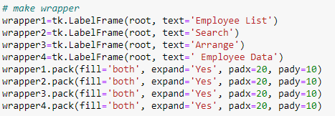
Description
III. Step by step.
Step 1: Import Tkinter and set up the screen dimension and title
Step 2: Make all needed wrapper

Slide 6
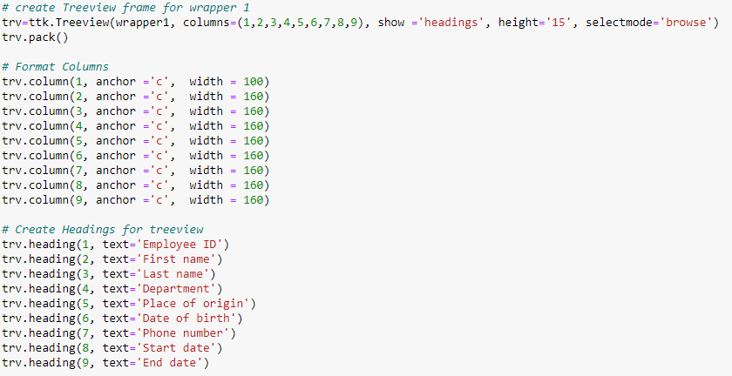
Description
III. Step by step.
Step 3: Create Treeview frame for wrapper 1

Slide 7
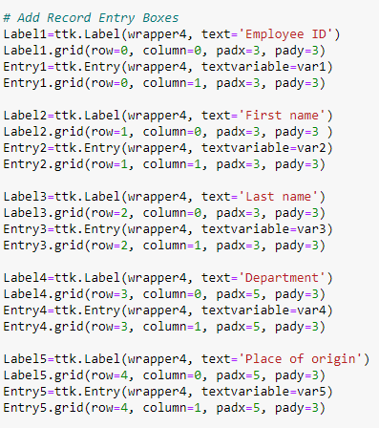
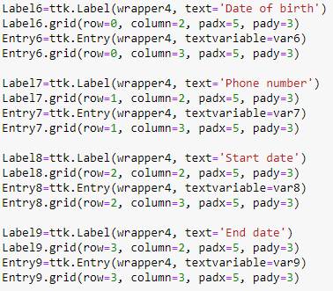
Description
III. Step by step.
Step 4: Create entry boxes for data entry

Slide 8
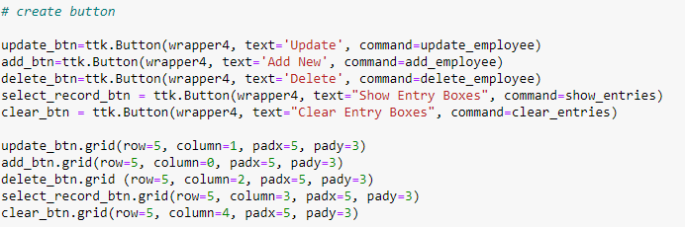
Description
III. Step by step.
Step 5: Create button

Slide 9
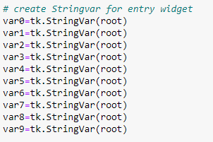
Description
III. Step by step.
Step 7: Create StringVar for entry widget

Slide 10
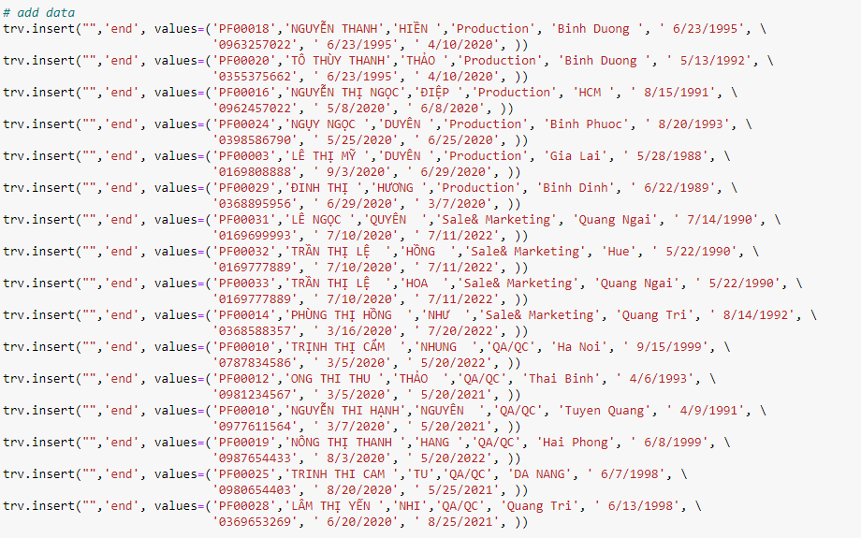
Description
III. Step by step.
Step 8: add data

Slide 11
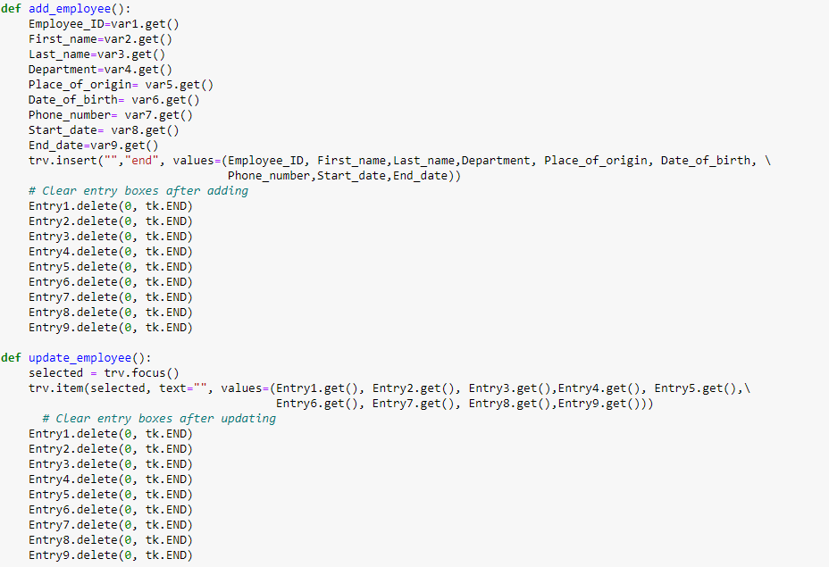
Description
III. Step by step.
Step 9: solving event

Slide 12
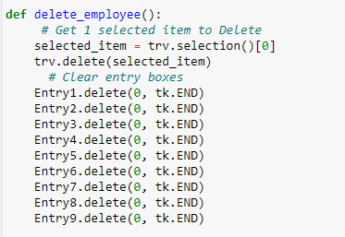
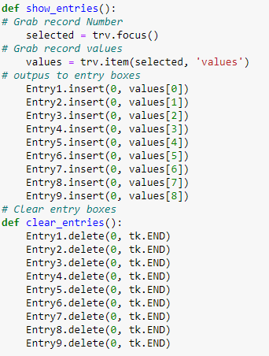
Description
III. Step by step.
Step 9: solving event

Slide 13
B. APPLICATION STRENGTH & WEAKNESS NEXT ACTIONS

Slide 14
Next steps:
II. Describe the all function of application.
Add new employee
Search by
Arrange by
Update employee,
Delete employee.
Develop function of search data by, arrange data by, delete all, delete many row, validate data, exit data, scroll bar for Treeview.
Add more information manage fields based on demand of user.
Connect this data to Excel or other database management system (SQL) to save update from entry.

Slide 15
SWOT Analysis for Application
Strengths
Weaknesses
Safer data storage than normal excel file
Easy tracking data.
More user can use at the same time
Have not finished all functions
Exits functions need to be considered to optimize for run smoothly and correctly.
SWOT
Analysis
Opportunities
Threats
Professional management
Manage data easily
Save time on data management
Put wrong data from user without validate function
END OF REPORT

Slide 16


